Slide 1

Benchmarking Sorting Algorithms & Searching with a Binary Search Tree
Ben Adams

Slide 2
Binary Search Tree Motivation and Properties
Motivation: A Binary Search Tree is a data structure that behaves much like the binary search algorithm. That is, it allows the programmer to search for an item in fewer comparisons.
Properties:
1. No duplicates allowed
2. Inorder traversal gives sorted order
3. Catalan formula provides number of possible BSTs given n nodes
4. Each node has right children with greater values and left children with smaller values than itself
Let’s take a look at Properties 2 and 3 in more detail…

Slide 3
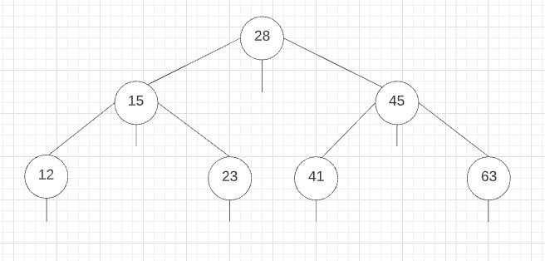

Property 2 : Inorder Traversal -> Sorted Order
Trick :
Trace border of drawing
Every time you cross a vertical line, add element to inorder list
Inorder: 12, 15, 23, 28, 41, 45, 63
Gives Sorted Order !

Slide 4
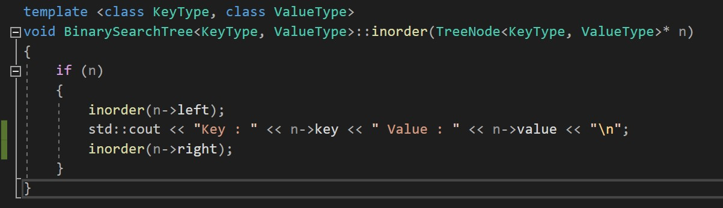
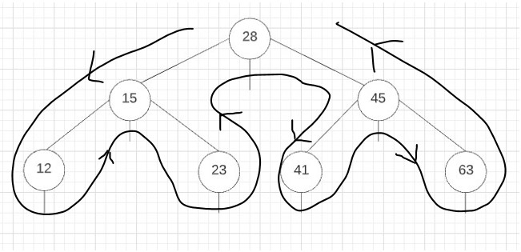
Code Snippet: Inorder Traversal (Recursive)

Slide 5
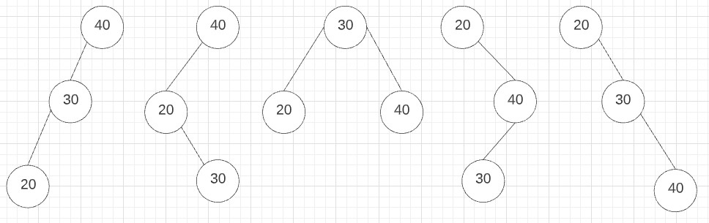
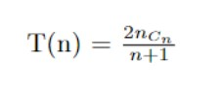
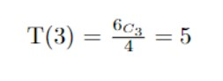
Property 3 : Catalan Formula for Number of Trees
Let : n = 3, Inorder : 20, 30, 40
There are 5 trees
that satisfy these conditions

Slide 6
Catalan Formula – Another Approach
N : | 0 | 1 | 2 | 3 | 4 | 5 | 6
 | 1 | 1 | 2 | 5 | 14 | 42 | ?
Can we find T(6) using some other method…

Slide 7
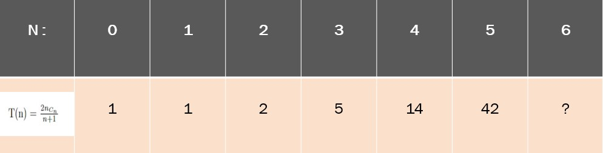
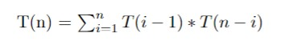
Recursive Formula for Number of Trees
T(6) = 1*42 + 1*14 + 2*5
+ 5*2 + 14*1 + 42*1 = 132
T(6) = T(0)*T(5) + T(1)*T(4) + T(2)*T(3)
+ T(3)*T(2) + T(4)*T(1) +T(5)*T(0)
Yes, using this recursive formula!!

Slide 8
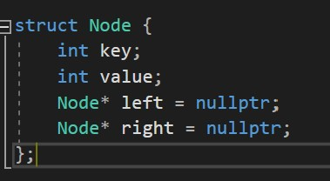
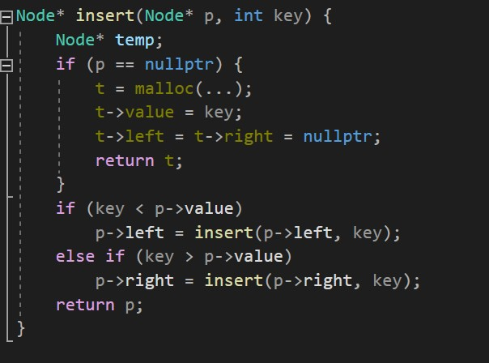
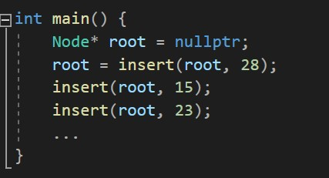
Code Snippet : Insert (Recursive)
Let’s take a look at inserting in a BST…

Slide 9
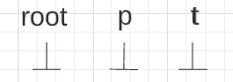
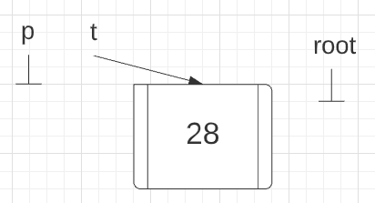
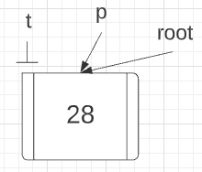
Recursive Insert: Walkthrough
Stage 1a : Insert 28
Algorithm:
1. If p is null, create node
2. Else, find location to insert by recursively comparing key with p->value
3. Insert node
Stage 1b : Insert 28
Stage 2a : Insert 15

Slide 10
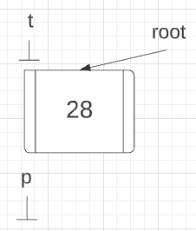
Recursive Insert: Walkthrough
Stage 2a : Insert 15
Algorithm:
1. If p is null, create node
2. Else, find location to insert by recursively comparing key with p->value
3. Insert node
Stage 2b : Insert 15

Slide 11
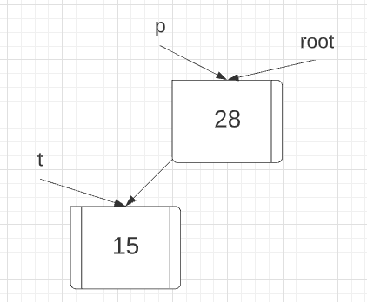
Recursive Insert : Walkthrough
Stage 2b : Insert 15
Algorithm:
1. If p is null, create node
2. Else, find location to insert by recursively comparing key with p->value
3. Insert node
Stage 2c : Insert 15
. . . WLOG
For All
Other
Insertions

Slide 12
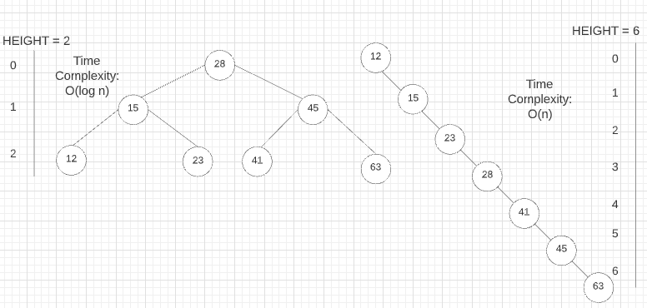
Binary Search Tree : Drawback
No control over height of tree (depends on insertion order)
Best Case: Random insertion
Worse Case: Sequential insertion
What if we want to control height?
Use AVL -- Height-balanced BST

Slide 13
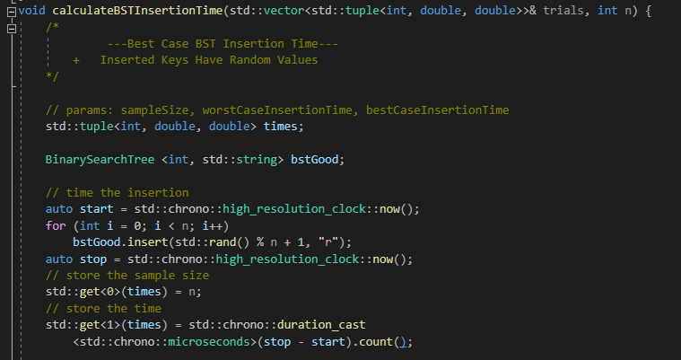
Demo : Time Complexity of BST Insertion
Best Case: Random Insertion
Worse Case: Sequential Insertion

Slide 14
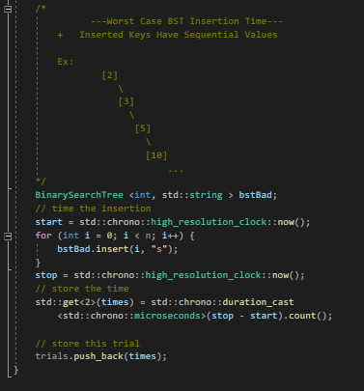
Demo : Time Complexity of BST Insertion
Best Case: Random insertion
Worse Case: Sequential insertion

Slide 15
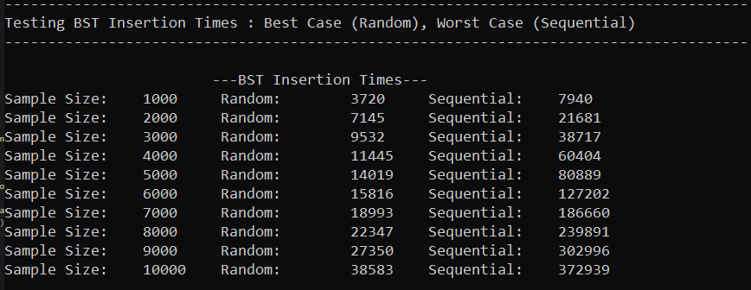
Demo : Time Complexity of BST Insertion
Best Case: Random insertion
- O(logn)
Worse Case: Sequential insertion
– O(n)
BST Insertion Runtimes for Varying Input Sizes Under Best & Worst Case Insertion Orders. (Runtime in Microseconds)

Slide 16
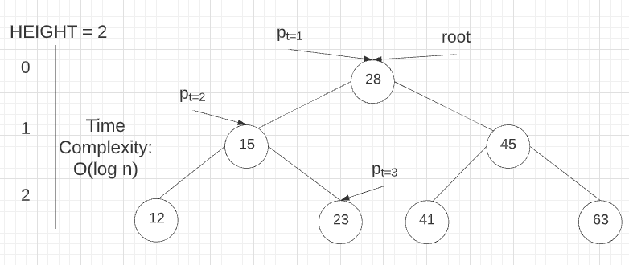
Binary Search Tree : Searching
Let’s take a look at searching in a BST
Search : Key = 23
Algorithm:
1. Recursively compare key to current node’s value starting with the root
2. Less than, go left, greater than, go right, equal, element found
3. If pointer becomes null, element not found
Notes:
+ Subscript t is a time index which indicates order of execution
+ Time complexity is O(h) where logn <= h <= n
+ We expect O(logn) but depends on insertion order

Slide 17
Airline Demo : Searching No Fly List
We use a BST to hold the No-Fly List
We compare each person on our passenger manifest to the No-Fly List
We verify each passenger
Note: Hashing would be a better technique
for this particular application
Oops, it looks like Ezra and Axel won’t be verified to fly today!

Slide 18
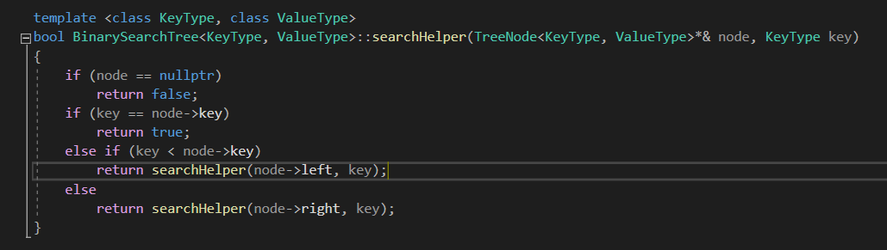
Code Snippet: Search (Recursive)
Note: This is tail recursion

Slide 19
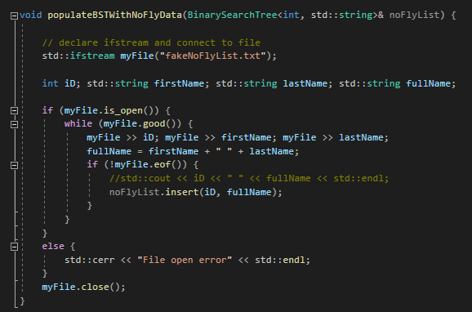
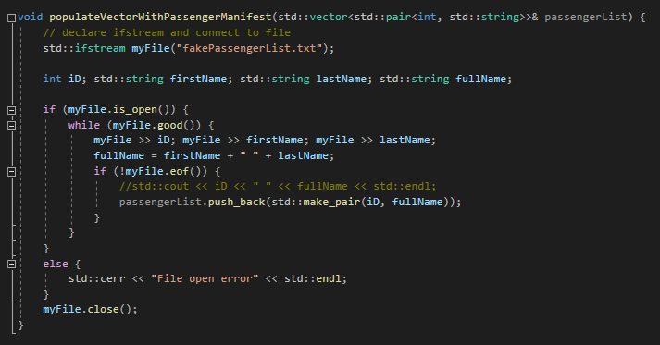
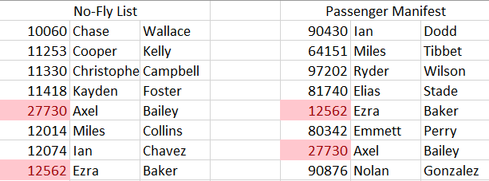
Code Snippet:

Slide 20
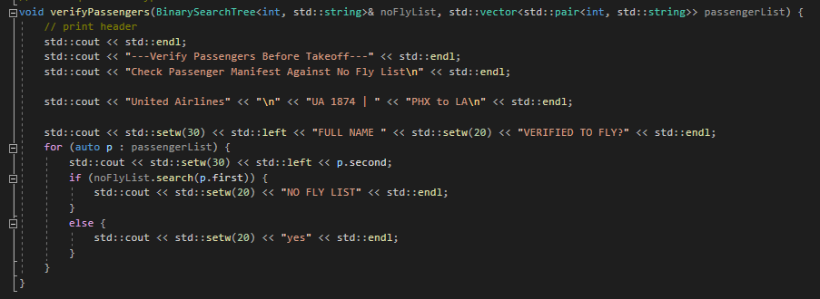
Code Snippet:

Slide 21
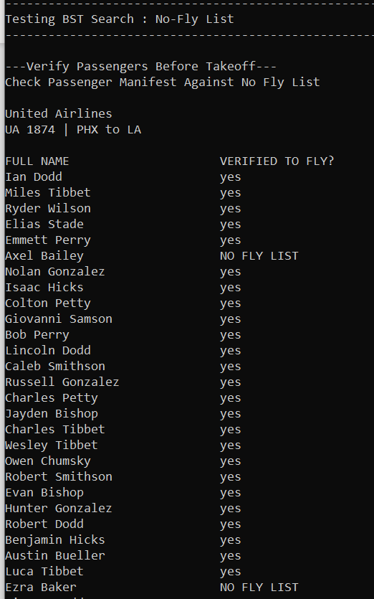
Demo : Searching BST
We use a BST to hold the No-Fly List
We compare each person on our passenger manifest to the No-Fly List
We verify each passenger
Note: Hashing would be a better technique
for this particular application

Slide 22
Benchmarking Sorting Algorithms Motivation and Properties
Motivation: To benchmark sorting algorithms using various data structures. The runtime data will be recorded and plotted to graphically illustrate the Big-O Time Complexity of each algorithm.
Goals:
1. To demonstrate Big-O Time Complexity
2. To demonstrate recursively defined structures
3. To demonstrate well-known sorting algorithms
Note: Because recursive algorithms make use of the call stack… and because the call stack
is constrained by system resources… and because our sample sizes are so large… we are unable to use
recursive algorithms to sort our data. Thus, we take an iterative approach.

Slide 23
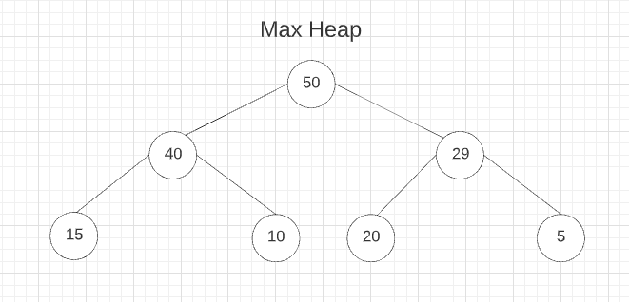
Heap and Priority Queue
A priority queue has elements which are inserted in the order received. Upon deletion, search for highest priority element and remove
Depending on the implementation, we can say the larger the number, the higher the priority (like max heap)… or conversely the smaller the number, the higher the priority (like min heap).
By repeatedly removing the highest priority element and storing it in a separate data structure, we get sorted order!
This behavior can be achieved with a different data structure… the heap!
Heap properties:
1. Must be a complete tree (height always logn)
2. Every element has value greater than each of its descendants (max heap)
3. Only root element may be deleted (highest priority element, similar to PQ !)

Slide 24
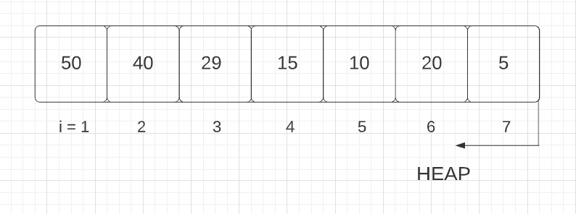
Heap Sort : Walkthrough
Algorithm:
1. Create heap of n elements
2. Delete from heap one-by-one
3. Copy deleted element to free space
Note: For the walkthrough, we’ll assume Step 1 has already been completed
Logical tree representation.
Parent = i/2
Left Child = 2i
Right Child = 2i + 1
Array-based implementation

Slide 25
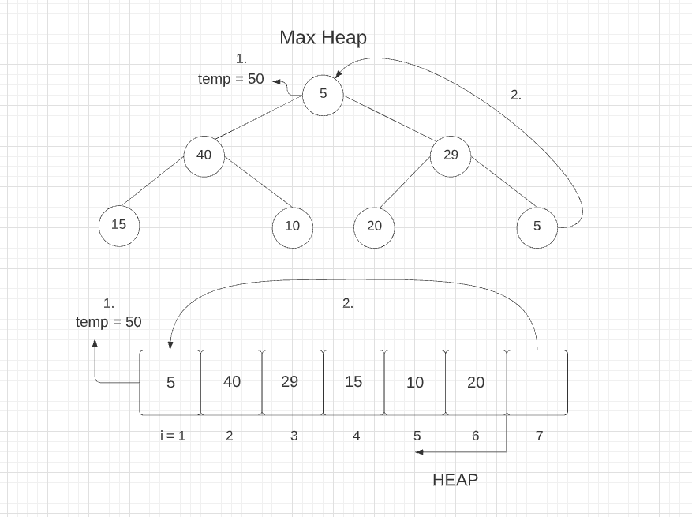
Heap Sort : Walkthrough
Algorithm:
1. Create heap of n elements
2. Delete from heap one-by-one
3. Copy deleted element to free space
Parent = i/2
Left Child = 2i
Right Child = 2i + 1
Delete root -> take value in temp
Move last element in complete binary tree order to root

Slide 26
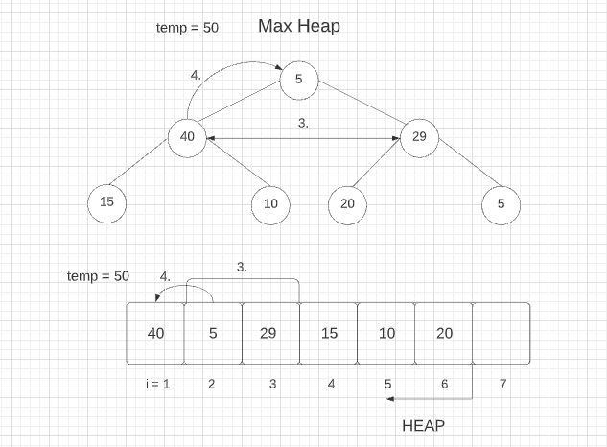
Heap Sort : Walkthrough
Algorithm:
1. Create heap of n elements
2. Delete from heap one-by-one
3. Copy deleted element to free space
Parent = i/2
Left Child = 2i
Right Child = 2i + 1
3. Compare children of new root node. Which is greater?
4. Compare that node with root node. Swap if greater.

Slide 27
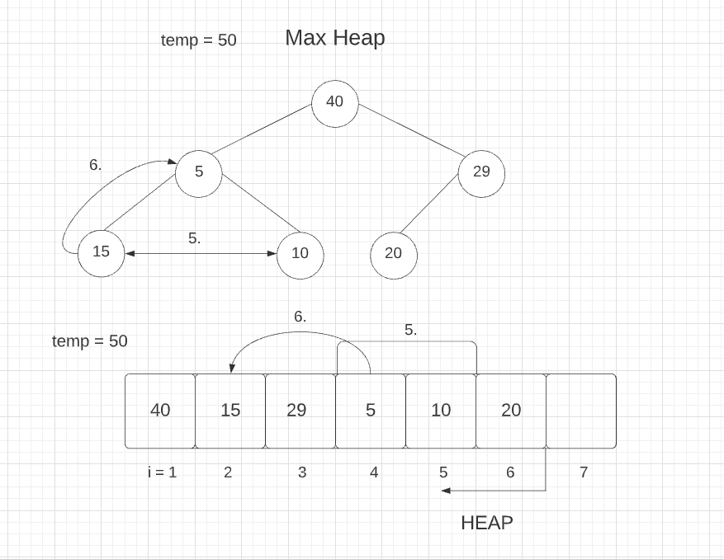
Heap Sort : Walkthrough
Algorithm:
1. Create heap of n elements
2. Delete from heap one-by-one
3. Copy deleted element to free space
Parent = i/2
Left Child = 2i
Right Child = 2i + 1
5. Compare current node’s children. Which is greater?
6. Compare that node with it’s parent. Swap if greater.

Slide 28
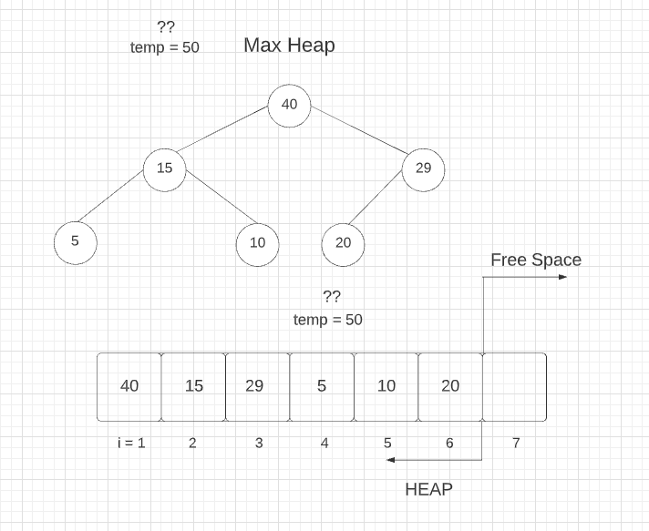
Heap Sort : Walkthrough
Algorithm:
1. Create heap of n elements
2. Delete from heap one-by-one
3. Copy deleted element to free space
Parent = i/2
Left Child = 2i
Right Child = 2i + 1
Great, now the elements are back in heap order.
But what should we do with the deleted element… t = 50?

Slide 29
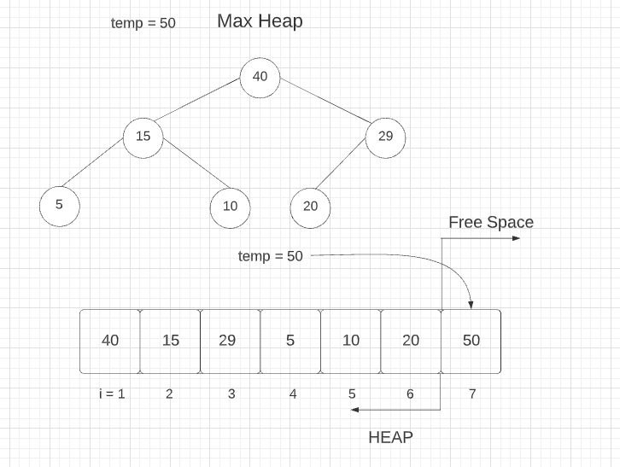
Heap Sort : Walkthrough
Algorithm:
1. Create heap of n elements
2. Delete from heap one-by-one
3. Copy deleted element to free space
Parent = i/2
Left Child = 2i
Right Child = 2i + 1
… Store it in the newly available free space in the array (outside the heap)

Slide 30
Heap Sort : Walkthrough
Algorithm:
1. Create heap of n elements
2. Delete from heap one-by-one
3. Copy deleted element to free space
Parent = i/2
Left Child = 2i
Right Child = 2i + 1
What happens if we repeat this process? Delete the new root? Bring last element in its place. Upheap (shuffle) to get back in heap order? Store removed element in newly available free space?

Slide 31
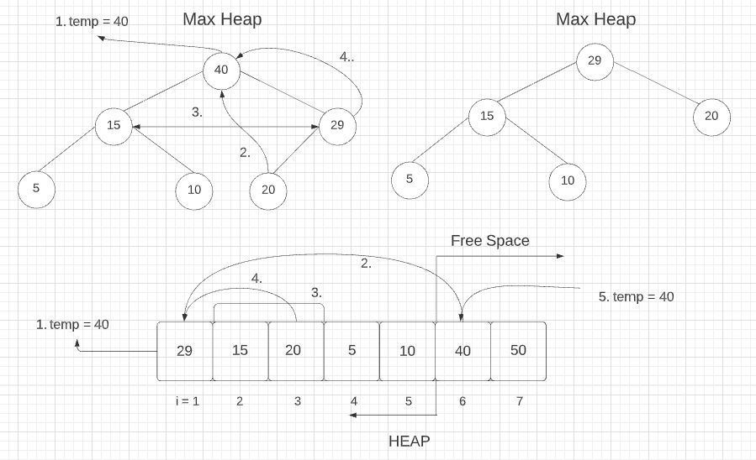
Heap Sort : Walkthrough
Algorithm:
1. Create heap of n elements
2. Delete from heap one-by-one
3. Copy deleted element to free space
Parent = i/2
Left Child = 2i
Right Child = 2i + 1
It yields a sorted list!!
Note: In this implementation, no auxiliary data structure is needed to hold the sorted elements

Slide 32

Merge Sort :
Algorithm:
1. Recursively divide right and left-side lists in half
2. Recursively merge when single element reached
Recursive Merge Sort | Graphic credit: Geeks For Geeks

Slide 33
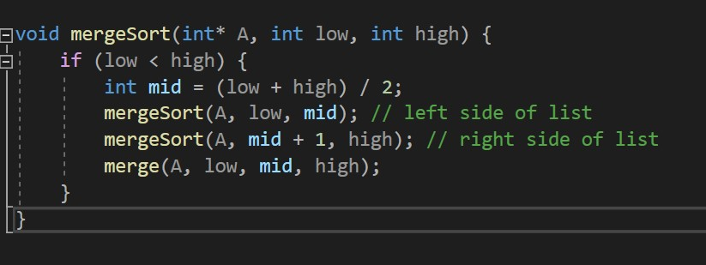
Code Snippet : Merge Sort (Recursive)
Note: The above code snippet is the recursive implementation of
merge sort. Due to resource constraints… and large sample sizes…
this project used iterative merge sort when benchmarking algorithms
Code credit: The iterative merge sort used in this project was adapted from Geeks For Geeks

Slide 34
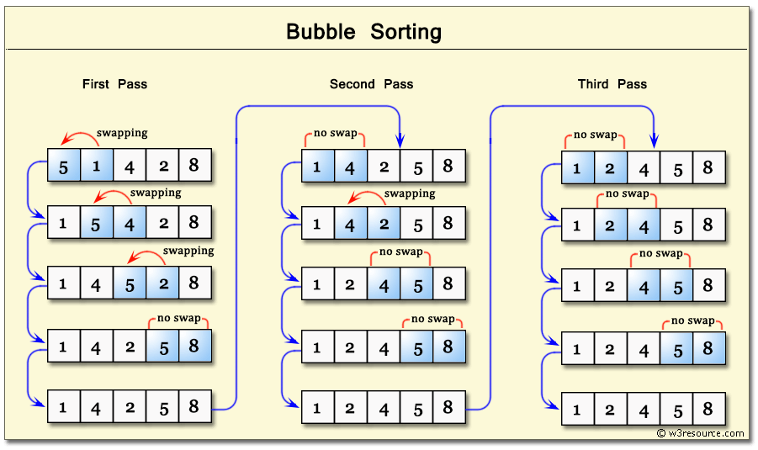
Bubble Sort :
Algorithm:
1. Take a nested loop and compare adjacent elements starting from the beginning of the list
2. Swap if the element at low index has greater value than element at high index
3. Repeat until we can pass through the entire list without swapping any elements
Bubble Sort | Graphic credit: w3resource.com

Slide 35
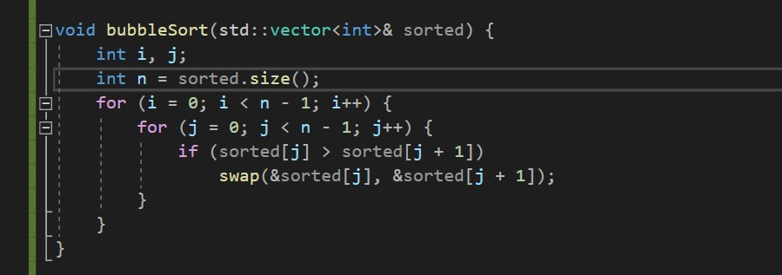
Code Snippet : Bubble Sort
Note the nested loop gives O(n^2) time complexity

Slide 36
Time Complexity :
Data Structure | Insert | Remove
Priority Queue | O(1) | O(n)
Heap | O(logn) | O(logn)
Let’s analyze the time complexity of each of these algorithms :
1. Priority Queue
2. Heap Sort
3. Merge Sort
4. Bubble Sort
5. STL Quick Sort
Data Structure | Algorithm | Time Complexity | Space Complexity
Priority Queue | Pq.remove() | O(n^2) | O(n)
Heap | Heap Sort | O(nlogn) | O(1)
Vector | Merge Sort | O(nlogn) | O(n + logn)
Vector | Bubble Sort | O(n^2) | O(1)
Vector | STL Quick Sort | O(nlogn) | O(logn)
Let’s view our runtime data graphically …

Slide 37
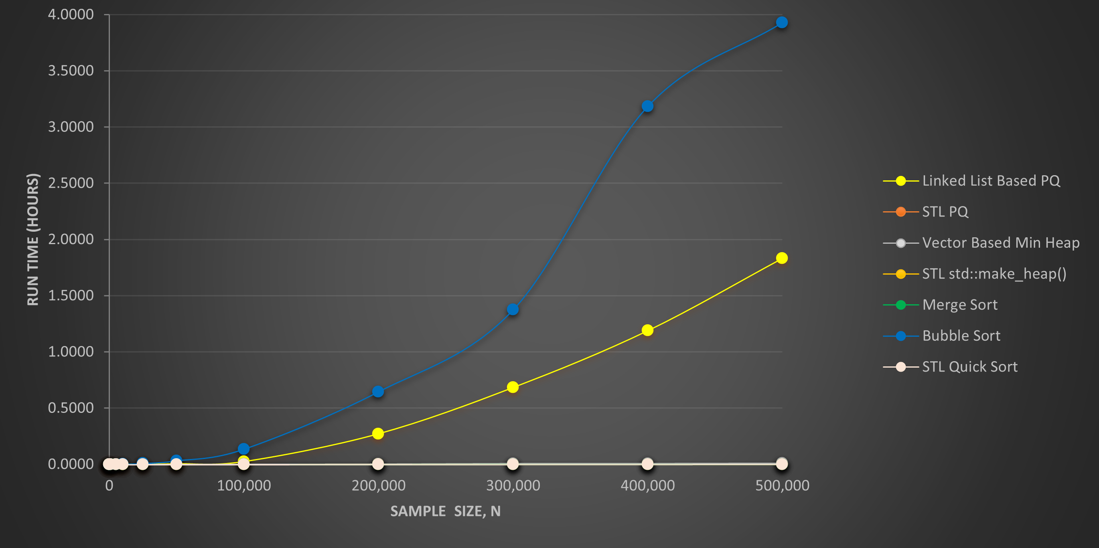
Note: The O(n^2) algorithms are so slow that we can barely see the other data. Let’s remove them !

Slide 38
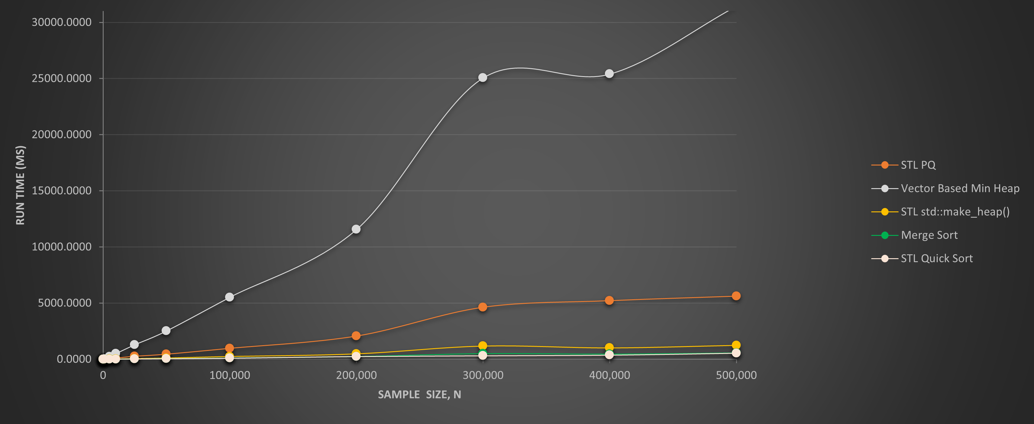
Note: Now the Vector Based Min Heap is obscuring the other data… Let’s remove it !

Slide 39
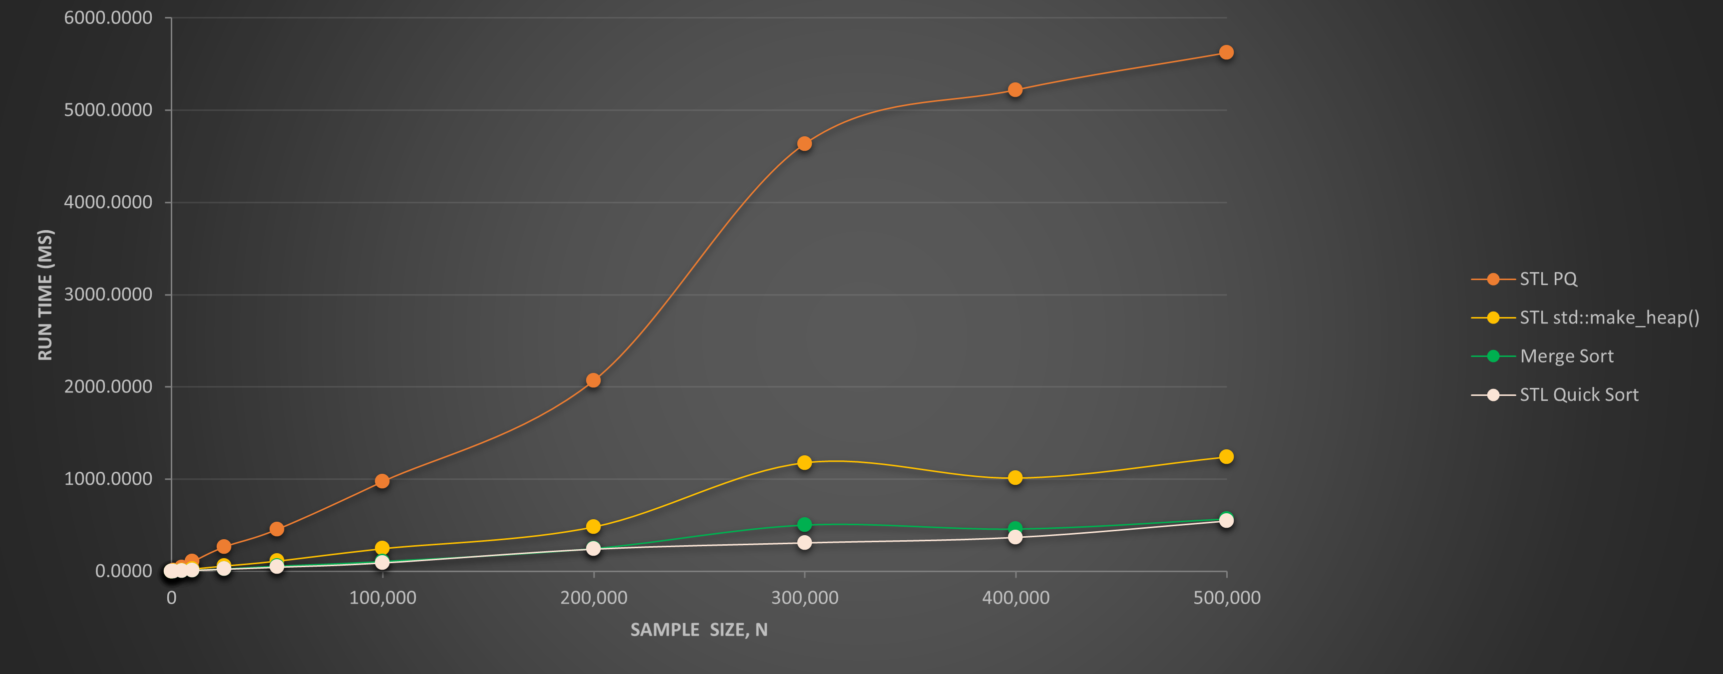
Note: Now the STL PQ is the culprit… Let’s remove it !

Slide 40
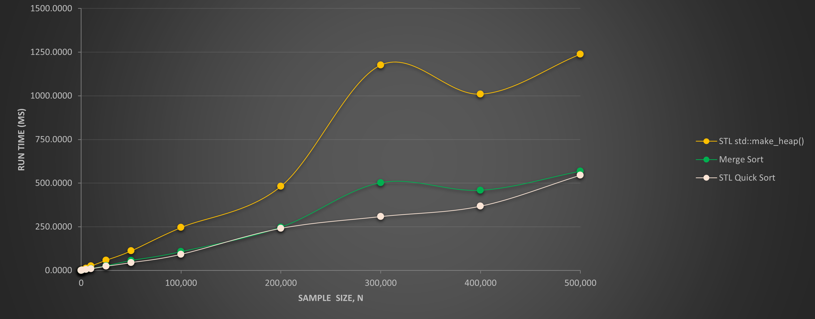
Note: There’s some noise around N = 400,000 for std::make_heap()… Constant factors matter !

Slide 41
Runtime Data (Milliseconds)

Slide 42
Runtime Data (Seconds)

Slide 43
Runtime Data (Minutes)

Slide 44
Runtime Data (Hours)

Slide 45





THE END . . .

